Slide 1
GSKY User Guide
A distributed geospatial data server exposing OGC services
Copyright © 2018 by National Computational Infrastructure, Canberra, ACT, Australia.

Slide 2
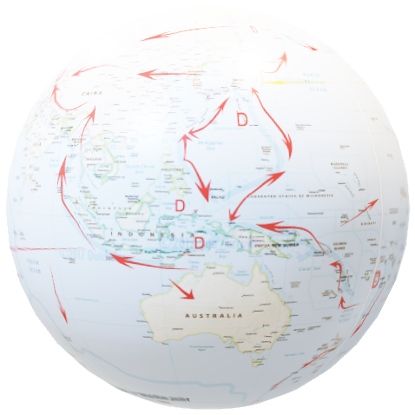
Using TerriaMap (CSIRO) with GSKY (NCI)
NATIONAL MAP
“TerriaJS was born late 2014 thanks to NationalMap. It started as a web based platform. The Australian NationalMap platform contributed greatly in opening data by government agencies and in discovering and consuming open data by general public, industry, academia and the government itself. NationalMap is managed and maintained by: Digital Transformation Agency - product ownership, Geoscience Australia - product hosting, Data61 Terria - product software development.”^{[Ref]}
Next slide is a non-technical user guide.
Three slides that follow it will show the process with code snippets.
GSKY_OWS_Server.docx for details.
It will take approximately 8 minutes to watch this animation.
Use GSKY_Terria_Interaction.pptx for controlled slideshow at your own pace.
DISCLAIMER
Only some relevant code snippets from TerriaMap (TerriaJS-specs.js) and GSKY (ows.go) are shown. They give pointers to understand the programs by studying the full codes. It is out of scope to include all code. More details are given in the above Word document. Gaps exist in code descriptions and the information may change over time.
The slide show will begin in 5 seconds !
2

Slide 3
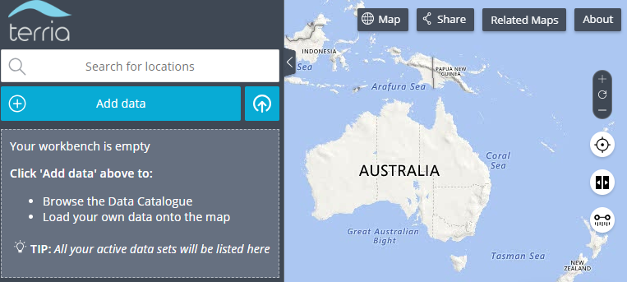
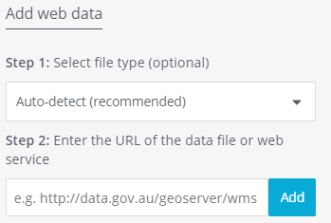
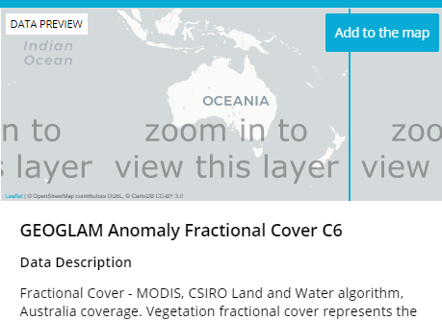
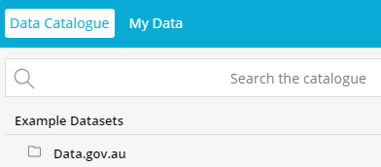
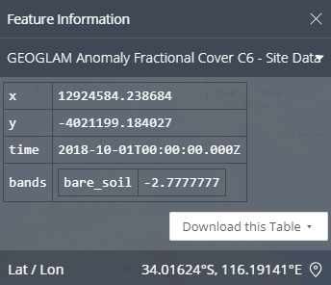
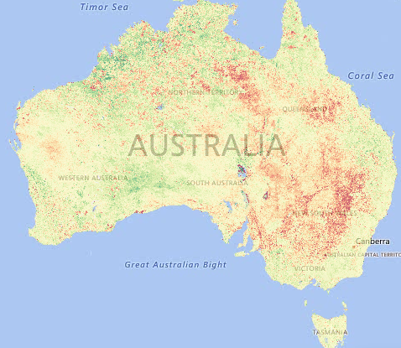
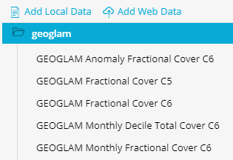
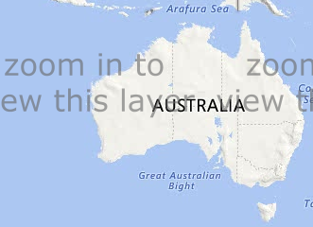
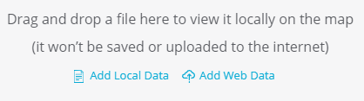
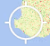

TerriaMap/GSKY User Guide
This animation will demonstrate the use of GSKY through TerriaMap, using the GEOGLAM data. There are more layers than those shown here, but not all may have displayable data. In some cases you will have to zoom in to see any overlaid data.
Add to the map
Add data
My Data
http://130.56.242.15/ows/geoglam
Add
GEOGLAM Anomaly Fractional Cover C6
Add Web Data
Next: Technical Details
1. Click: Add data
5. Click: A layer name
2. Click: My data
6. Click: Add to the map
3. Click: Add Web Data
7. Zoom: Use the mouse wheel
3
4. Type: Address of GSKY server. Click: Add
8. Click: On any pixel on the map

Slide 4






Acknowledgements

